Slide 1
Alternative tests

Slide 2
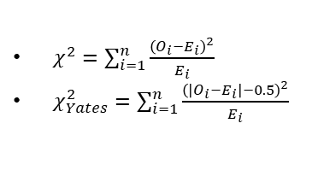
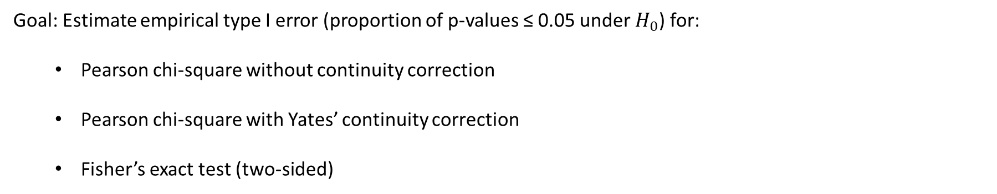
Type-I error
Goal: Estimate empirical type I error (proportion of p-values ≤ 0.05 under $H_{0}$) for:
  Pearson chi-square without continuity correction
  Pearson chi-square with Yates’ continuity correction
  Fisher’s exact test (two-sided)
$χ^{2}=\sum_{i=1}^{n}{\frac{{\left(O_{i}−E_{i}\right)}^{2}}{E_{i}}}$
$χ_{Yates}^{2}=\sum_{i=1}^{n}{\frac{{\left(\left|O_{i}−E_{i}\right|−0.5\right)}^{2}}{E_{i}}}$

Slide 3
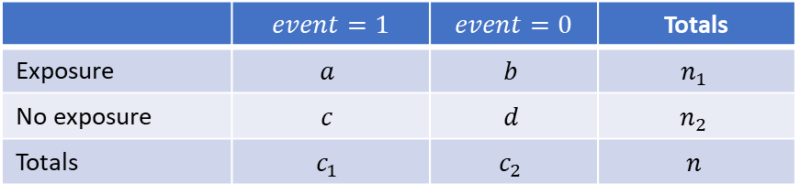
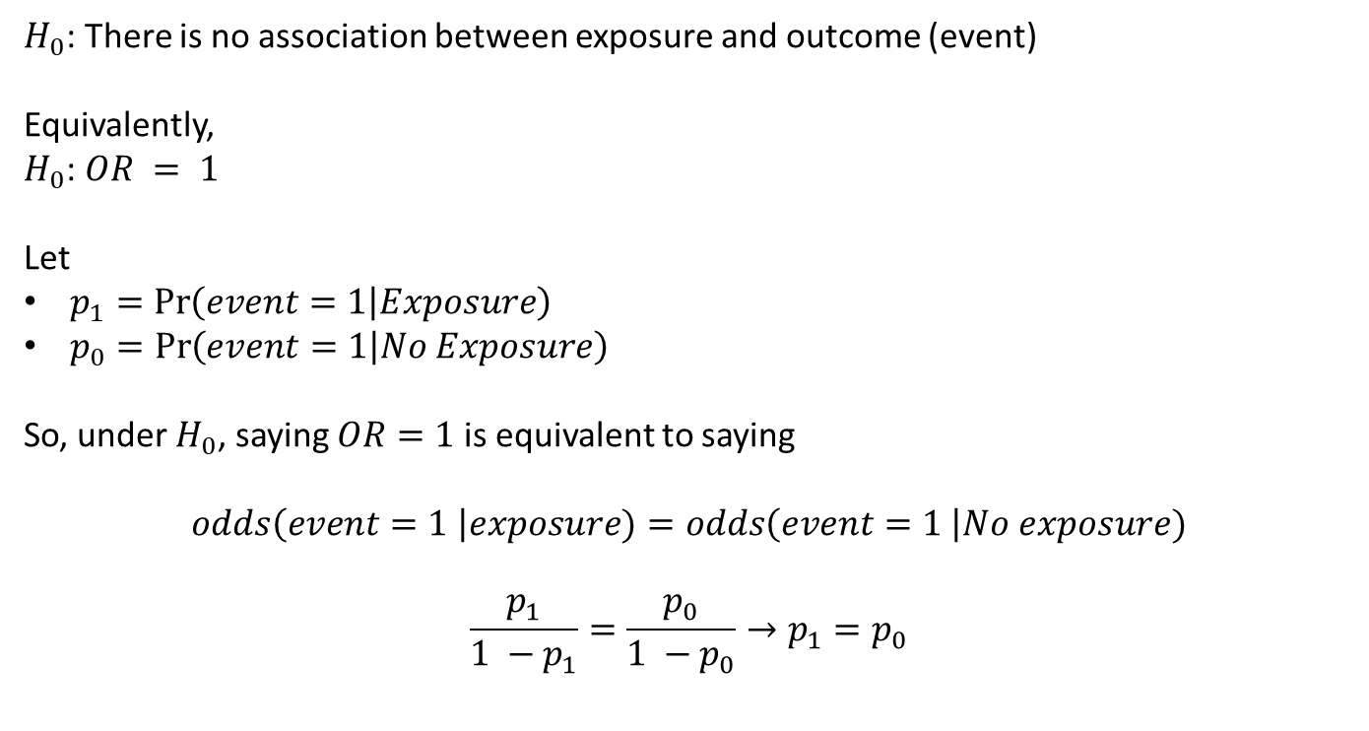
Type-I error
 | $$event=1$$ | $$event=0$$ | Totals
Exposure | $$a$$ | $$b$$ | $$n_{1}$$
No exposure | $$c$$ | $$d$$ | $$n_{2}$$
Totals | $$c_{1}$$ | $$c_{2}$$ | $$n$$
$H_{0}$: There is no association between exposure and outcome (event)
Equivalently,
$H_{0}$: $OR = 1$
Let
$p_{0}=Pr\left(event=1 | No Exposure\right)$
So, under $H_{0}$, saying $OR=1$ is equivalent to saying
$$odds\left(event=1 \right|exposure)=odds\left(event=1 \right|No exposure)$$
$$\frac{p_{1}}{1 −p_{1}}=\frac{p_{0}}{1 −p_{0}}→p_{1}=p_{0}$$

Slide 4
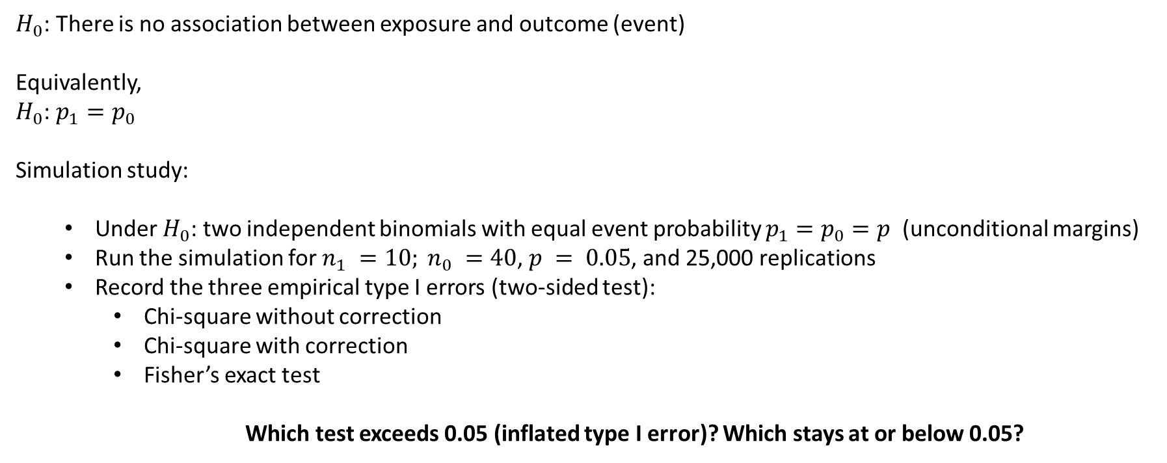
Type-I error
 | $$event=1$$ | $$event=0$$ | Totals
Exposure | $$a$$ | $$b$$ | $$n_{1}$$
No exposure | $$c$$ | $$d$$ | $$n_{2}$$
Totals | $$c_{1}$$ | $$c_{2}$$ | $$n$$
$H_{0}$: There is no association between exposure and outcome (event)
Equivalently,
$H_{0}$: $p_{1}=p_{0}$
Simulation study:
  Under $H_{0}$: two independent binomials with equal event probability $p_{1}=p_{0}=p$ (unconditional margins)
  Run the simulation for $n_{1} =10; n_{0} =40$, $p = 0.05$, and 25,000 replications
  Record the three empirical type I errors (two-sided test):
    Chi-square without correction
    Chi-square with correction
    Fisher’s exact test
    Which test exceeds 0.05 (inflated type I error)? Which stays at or below 0.05?

Slide 5
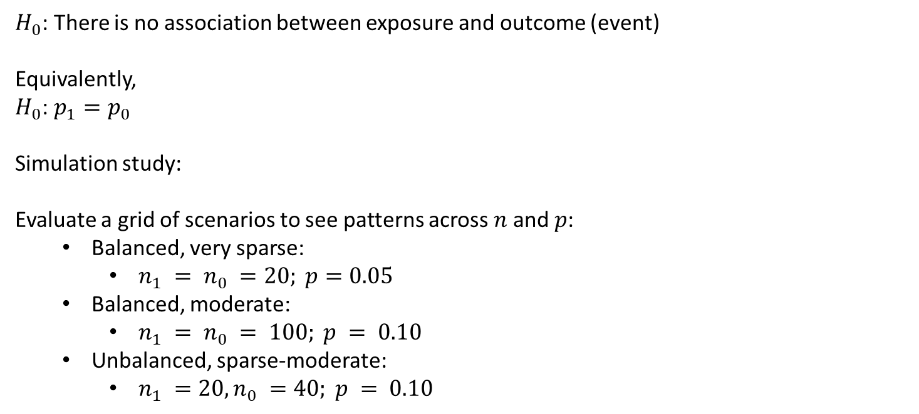
Type-I error
 | $$event=1$$ | $$event=0$$ | Totals
Exposure | $$a$$ | $$b$$ | $$n_{1}$$
No exposure | $$c$$ | $$d$$ | $$n_{2}$$
Totals | $$c_{1}$$ | $$c_{2}$$ | $$n$$
$H_{0}$: There is no association between exposure and outcome (event)
Equivalently,
$H_{0}$: $p_{1}=p_{0}$
Simulation study:
Evaluate a grid of scenarios to see patterns across $n$ and $p$:
  Balanced, very sparse:
    $n_{1} = n_{0} =20; p=0.05$
  Balanced, moderate:
    $n_{1} = n_{0} = 100; p = 0.10$
  Unbalanced, sparse-moderate:
    $n_{1} =20, n_{0} =40; p = 0.10$

Slide 6
sim_type1 <- function(n1, n0, p, reps = 50000, alpha = 0.05) {
p_chi_no_vec <- p_chi_y_vec <- p_fisher_vec <- rep(NA, reps)
for (i in 1:reps) {
# Generate counts under H0: p1 = p0 = p
x1 <- rbinom(1, n1, p) # events in group 1
x0 <- rbinom(1, n0, p) # events in group 0
tab <- matrix(c(x1, n1 - x1, x0, n0 - x0), nrow = 2, byrow = TRUE)
# Pearson chi-square (no correction; with Yates)
p_chi_no <- suppressWarnings(chisq.test(tab, correct = FALSE)$p.value)
p_chi_y <- suppressWarnings(chisq.test(tab, correct = TRUE)$p.value)
# Fisher's exact (two-sided)
p_fisher <- fisher.test(tab, alternative = "two.sided")$p.value
p_chi_no_vec[i] <- p_chi_no
p_chi_y_vec[i] <- p_chi_y
p_fisher_vec[i] <- p_fisher
}
res_tab <- data.frame(
n1 = n1, n0 = n0, p = p, reps = reps, alpha = alpha,
type1_chisq_no_correction = mean(p_chi_no_vec <= alpha, na.rm = TRUE),
type1_chisq_yates = mean(p_chi_y_vec <= alpha, na.rm = TRUE),
type1_fisher_two_sided = mean(p_fisher_vec <= alpha, na.rm = TRUE)
)
list(res = res_tab,
rej_chi_no = p_chi_no_vec,
rej_chi_y = p_chi_y_vec,
rej_fisher = p_fisher_vec)
}
set.seed(1)
res_small <- sim_type1(n1 = 20, n0 = 40, p = 0.1, reps = 10000)
res_small$res

Slide 7
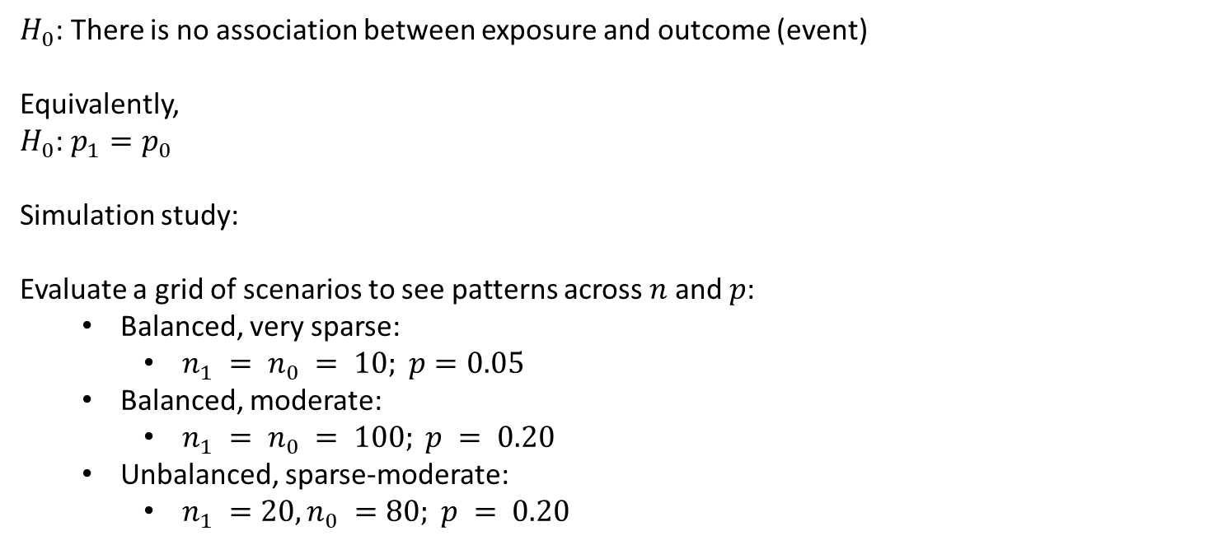
Type-I error
 | $$event=1$$ | $$event=0$$ | Totals
Exposure | $$a$$ | $$b$$ | $$n_{1}$$
No exposure | $$c$$ | $$d$$ | $$n_{2}$$
Totals | $$c_{1}$$ | $$c_{2}$$ | $$n$$
$H_{0}$: There is no association between exposure and outcome (event)
Equivalently,
$H_{0}$: $p_{1}=p_{0}$
Simulation study:
Evaluate a grid of scenarios to see patterns across $n$ and $p$:
  Balanced, very sparse:
    $n_{1} = n_{0} = 10; p=0.05$
  Balanced, moderate:
    $n_{1} = n_{0} = 100; p = 0.20$
  Unbalanced, sparse-moderate:
    $n_{1} =20, n_{0} =80; p = 0.20$

Slide 8
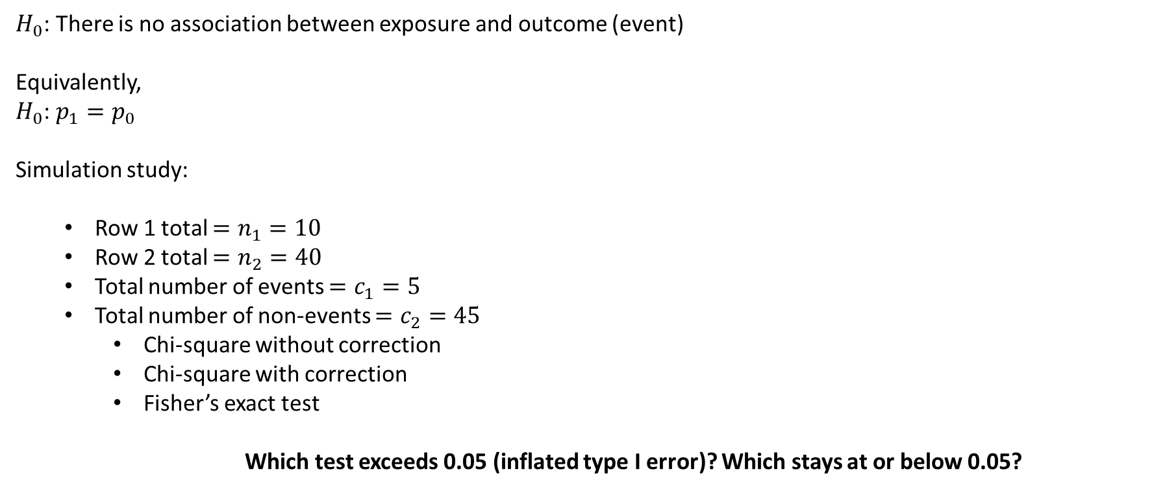
Type-I error
 | $$event=1$$ | $$event=0$$ | Totals
Exposure | $$a$$ | $$b$$ | $$n_{1}$$
No exposure | $$c$$ | $$d$$ | $$n_{2}$$
Totals | $$c_{1}$$ | $$c_{2}$$ | $$n$$
$H_{0}$: There is no association between exposure and outcome (event)
Equivalently,
$H_{0}$: $p_{1}=p_{0}$
Simulation study:
  Row 1 total $=n_{1}=10$
  Row 2 total $=n_{2}=40$
  Total number of events $=c_{1}=5$
  Total number of non-events $=c_{2}=45$
    Chi-square without correction
    Chi-square with correction
    Fisher’s exact test
    Which test exceeds 0.05 (inflated type I error)? Which stays at or below 0.05?

Slide 9
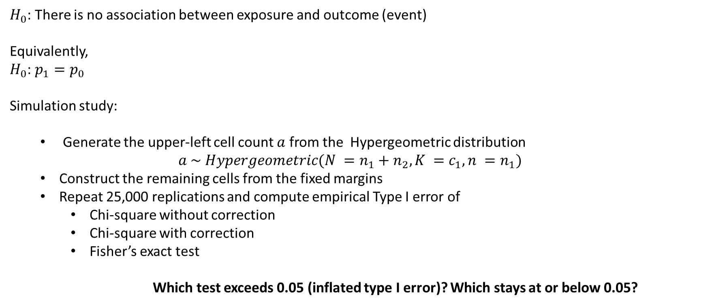
Type-I error
 | $$event=1$$ | $$event=0$$ | Totals
Exposure | $$a$$ | $$b$$ | $$n_{1}$$
No exposure | $$c$$ | $$d$$ | $$n_{2}$$
Totals | $$c_{1}$$ | $$c_{2}$$ | $$n$$
$H_{0}$: There is no association between exposure and outcome (event)
Equivalently,
$H_{0}$: $p_{1}=p_{0}$
Simulation study:
  Generate the upper-left cell count $a$ from the Hypergeometric distribution
  $$a \sim Hypergeometric(N =n_{1}+n_{2}, K =c_{1}, n =n_{1})$$
  Construct the remaining cells from the fixed margins
  Repeat 25,000 replications and compute empirical Type I error of
    Chi-square without correction
    Chi-square with correction
    Fisher’s exact test
    Which test exceeds 0.05 (inflated type I error)? Which stays at or below 0.05?

Slide 10
sim_type2 <- function(n1, n0, c1, c2, reps = 50000, alpha = 0.05) {
p_chi_no_vec <- p_chi_y_vec <- p_fisher_vec <- rep(NA, reps)
for (i in 1:reps) {
# Generate counts under H0: p1 = p0 = p
a <- rhyper(nn = 1,
m = c1,
n = c2,
k = n1)
tab <- matrix(c(a, n1 - a, c1 - a, c2 - (n1 - a)), nrow = 2, byrow = TRUE)
# Pearson chi-square (no correction; with Yates)
p_chi_no <- suppressWarnings(chisq.test(tab, correct = FALSE)$p.value)
p_chi_y <- suppressWarnings(chisq.test(tab, correct = TRUE)$p.value)
# Fisher's exact (two-sided)
p_fisher <- fisher.test(tab, alternative = "two.sided")$p.value
p_chi_no_vec[i] <- p_chi_no
p_chi_y_vec[i] <- p_chi_y
p_fisher_vec[i] <- p_fisher
}
res_tab <- data.frame(
type1_chisq_no_correction = mean(p_chi_no_vec <= alpha, na.rm = TRUE),
type1_chisq_yates = mean(p_chi_y_vec <= alpha, na.rm = TRUE),
type1_fisher_two_sided = mean(p_fisher_vec <= alpha, na.rm = TRUE)
)
list(res = res_tab,
rej_chi_no = p_chi_no_vec,
rej_chi_y = p_chi_y_vec,
rej_fisher = p_fisher_vec)
}
set.seed(1)
res_small <- sim_type2(n1 = 10, n0 = 40, c1= 5, c2 = 45, reps = 10000)
res_small$res

Slide 11
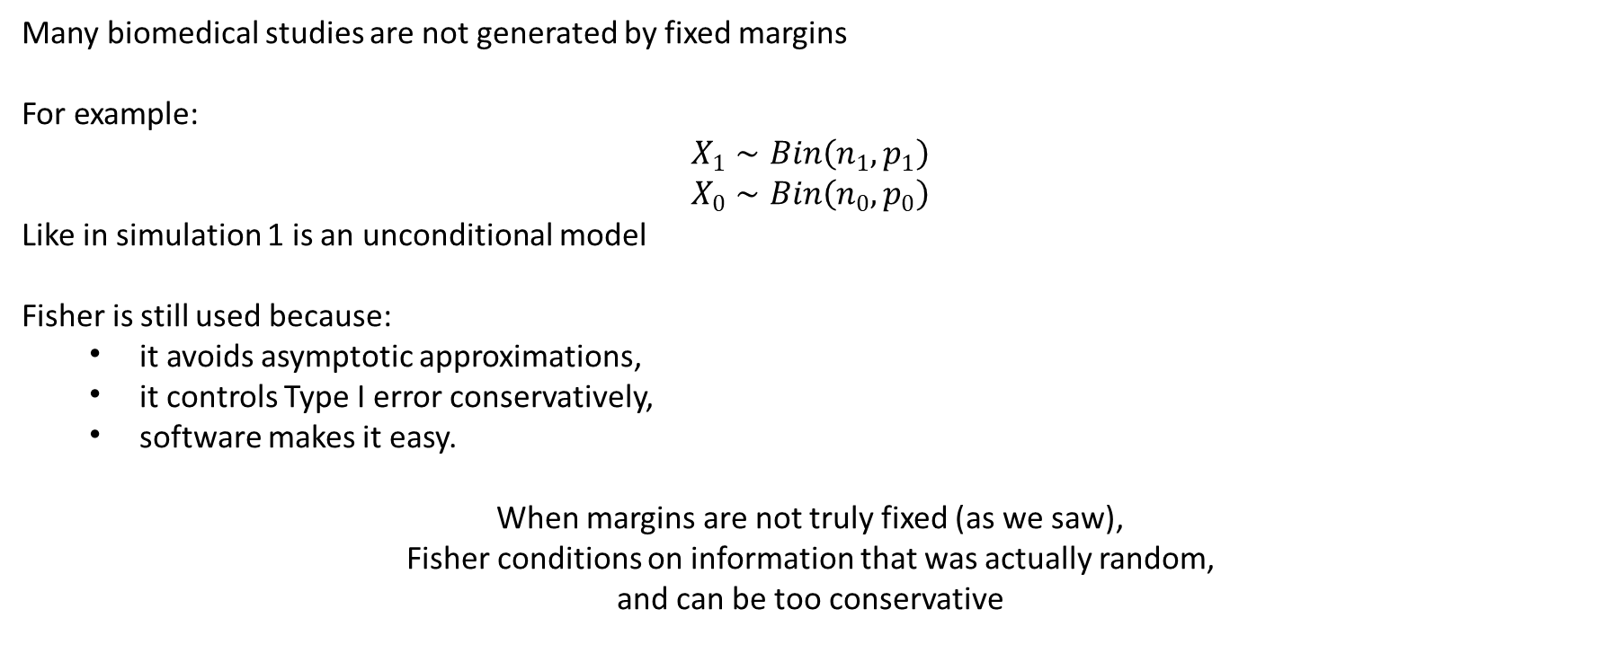
Fisher and Pearson chi-square
Many biomedical studies are not generated by fixed margins
For example:
$$X_{1}∼Bin\left(n_{1} , p_{1}\right)$$
$$X_{0}∼Bin\left(n_{0} , p_{0}\right)$$
Like in simulation 1 is an unconditional model
Fisher is still used because:
  it avoids asymptotic approximations,
  it controls Type I error conservatively,
  software makes it easy.
When margins are not truly fixed (as we saw),
Fisher conditions on information that was actually random,
and can be too conservative

Slide 12

Throughout the semester we relied mostly on sampling distributions
Today we compared exact and asymptotic sampling distributions
Next, we are going to look at a completely different framework for statistical inference
$P\left(\text{data}∣θ\right)$ vs $P\left(θ∣\text{data}\right)$

Slide 13
THANK YOU!

